Slide 1
Deep Finalyst
AI-Enhanced Automation for Financial Modelling and Market Analysis

Slide 2
The Problem
Financial institutions sit on large datasets consisting of billions in data points. These datasets grow every hour with new financial data from the market.
Large amounts of effort and working hours are put to perform tedious calculations and tracking stock prices for investment decisions
Students and analysts should focus on significant and meaningful tasks, such as generating insights and financial decision-making

Slide 3
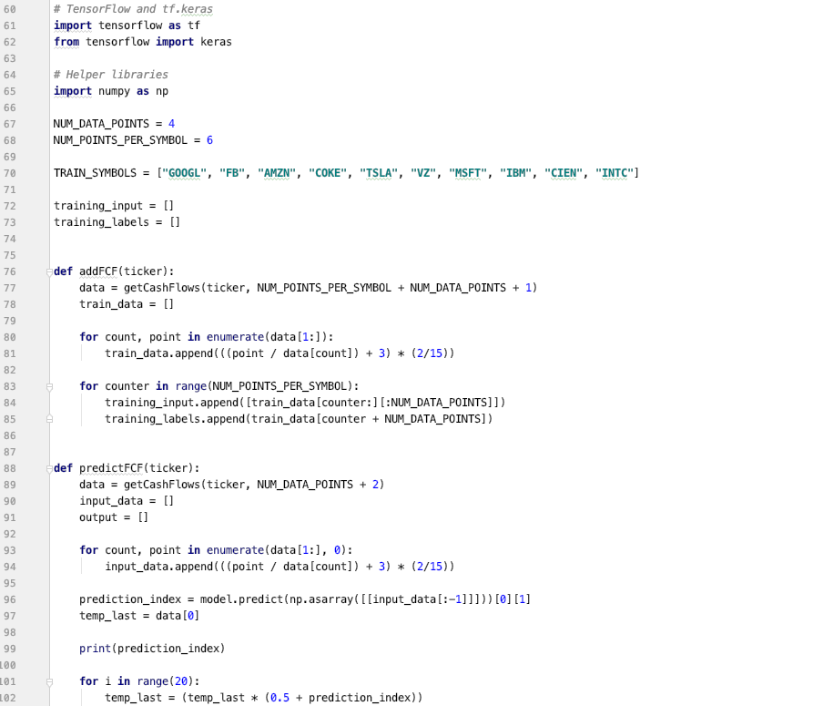
Our Solution
Automated financial modelling techniques for company valuatio
Artificial Intelligence based market trend analysis
Predicative power by trending analysis of company growth factors over time collected by Goldman Marquee API

Slide 4
DEMO TIME

Slide 5
Deep Finalyst
Automation, AI and Data Analytics
Accurately capture market trends
Efficiently evaluate companies using financial modelling.

Slide 6
Deep Finalyst
Grinds out the big data, so you don’t have to

